Slide 1



Leveraging Statistics & Machine Learning
to Accelerate 5G Adoption
A Strategic Approach for
Telecommunications Growth
AN6003 Group A – Team 9

Slide 2


Entering A New Era: 5G Adoption & Business Opportunity
5G Advantages
For successful 5G expansion, in 2023-2030, Chinese operators are projected to invest in mobile capex for
5G Adoption & Prediction in China
(% of total connections)
$320 billion ~ 20% global mobile capex
Business Problem
54%
12%
Leveraging machine learning to accurately identify potential 5G users for targeted marketing campaigns and optimized resource allocation.
2023
2030
45%
88%
Limeylia Ng

Slide 3
Dataset Introduction
A real dataset from a telecommunications company
140K records
feature variables
target variable
User Identification
User Information
Consumer Behavior Information
Excess Information
Broadband Information
Contract Information
Package Information
Data Saturation Information
Other Information
Label
10 variable groups
43 feature variables
Whether this user is converted to a 5G user this month
1 target variable
Wu Weiqiang

Slide 4
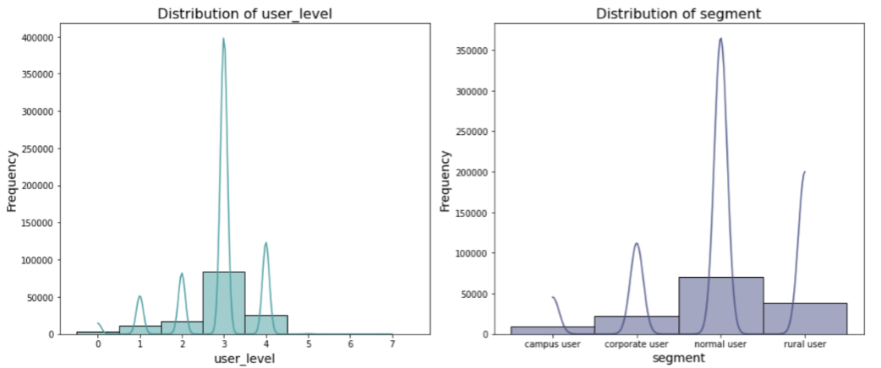
Data Preprocessing
Handling default values in variables
categorical variables
numerical variables
user_level
segment
Fill NAs with modes
Fill NAs with medians
multiple default values in feature variables within a single data record
Remove the records
Wu Weiqiang

Slide 5
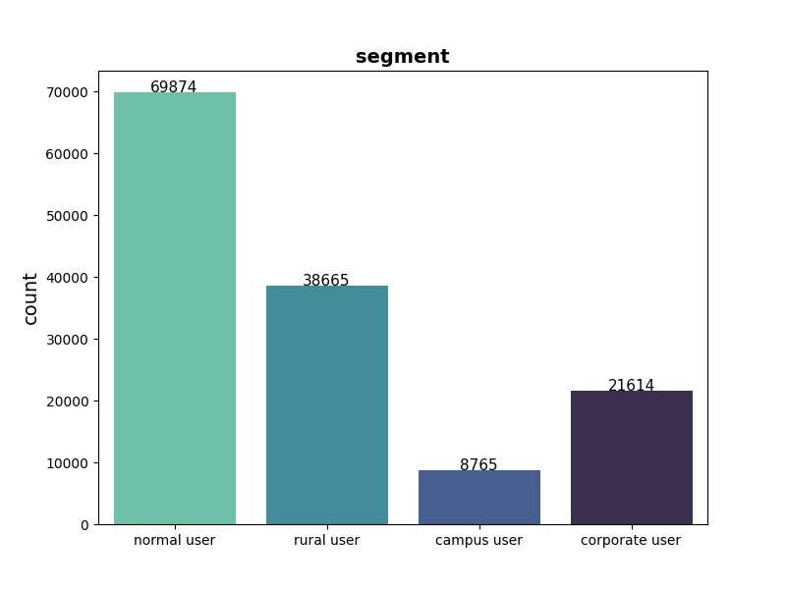
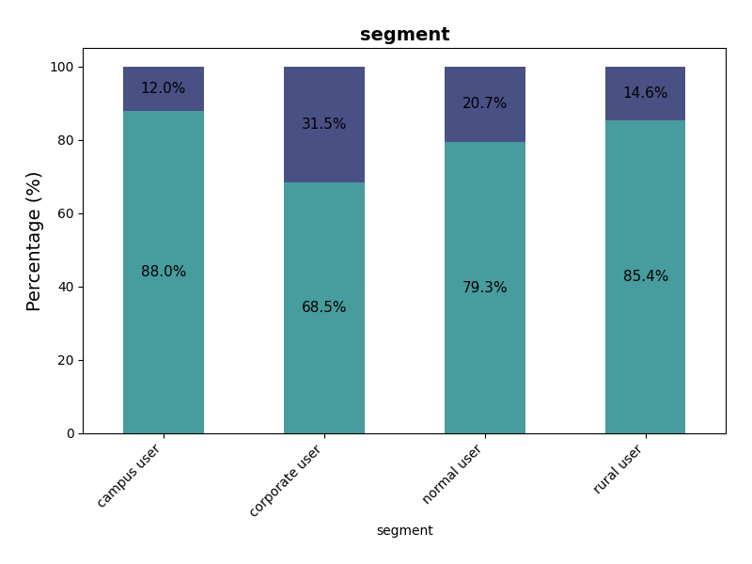
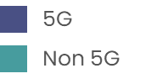
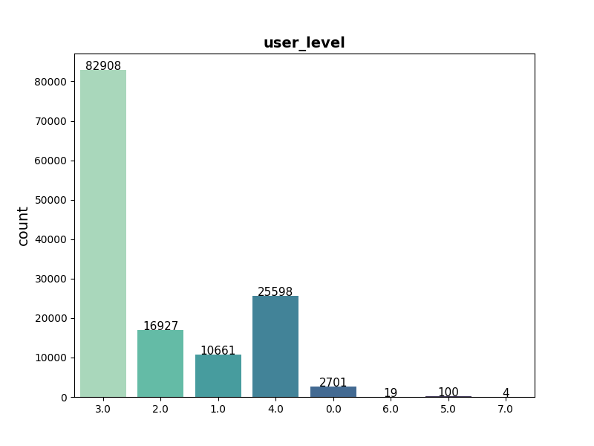
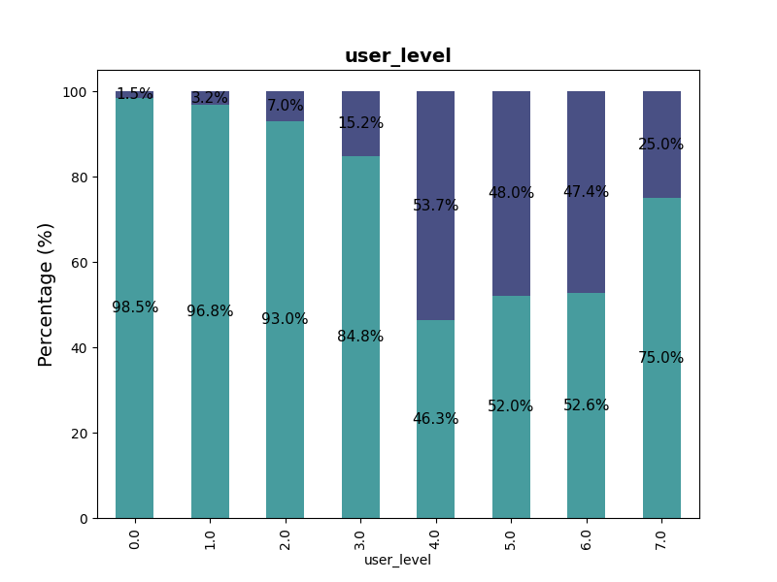
Segment
Exploratory
Data Analysis
The conversion rate of 5G is quite low, so there is great potential for future 5G growth. Besides, Unique patterns can be identified among different variables.
Corporate users have the highest 5G conversion rate,
while campus users have the lowest 5G rate and user amount.
User Level
80%
The distribution of 5G and non 5G users is quite unbalanced, with a ratio of 4:1.
non 5G users
Starting from user level 4, 5G conversion rate is
much higher than those of lower-level users.
Zhang Hang
5G
Non 5G
Notes:
After the data preparation, we do the exploratory analysis. First, let’s look at the circle on the left. From the data distribution, we found that nearly 80% of all users do not convert to 5G. In other words, the conversion rate is only about 20%. So, there is great potential for future 5G growth. Then we can find unique patterns among different variables. From the right top, we can tell that different user segments differ on 5g conversion rate. And from the right bottom, you can see that: Starting from user level 4, 5G conversion rate is much higher than those of lower-level users.

Slide 6
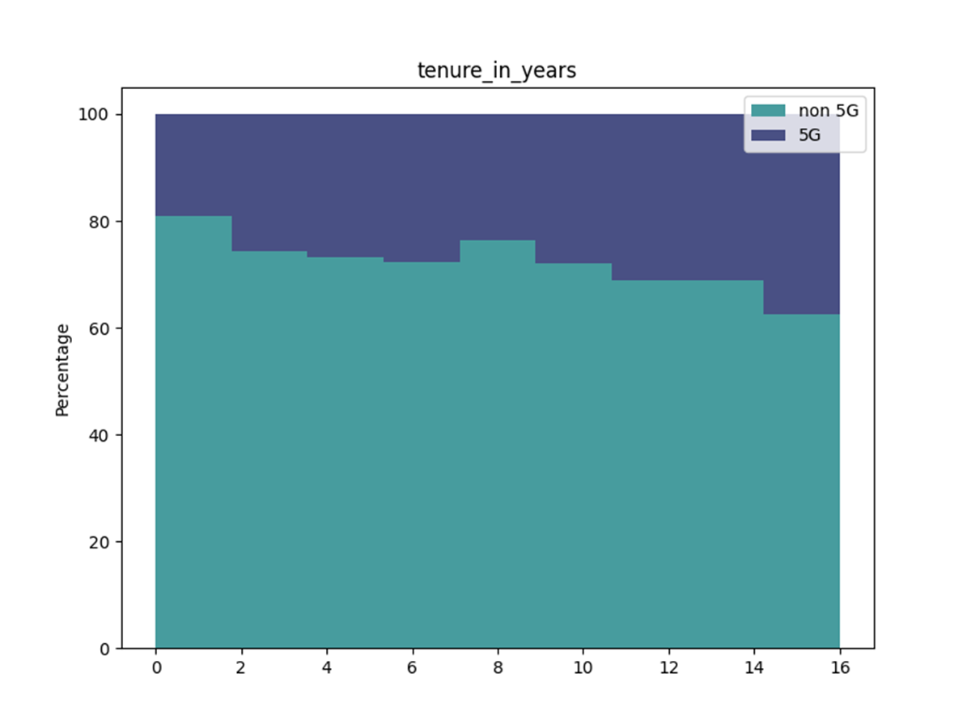
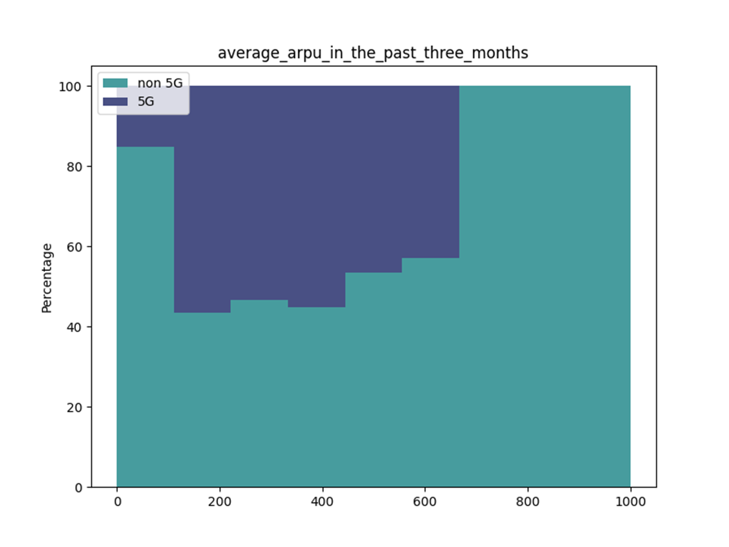
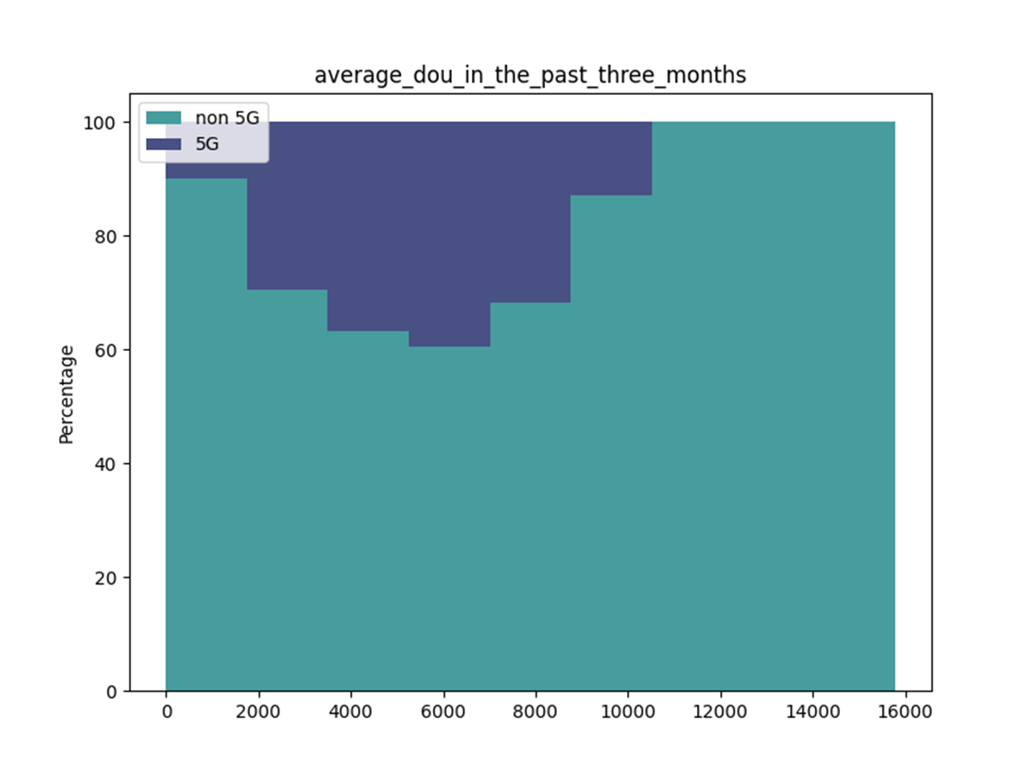
Trend of 5G Conversion
The proportion of 5G conversions varies with the growth of the numerical variable.
Tenure in Years
Avg ARPU in past 3 months
Avg DOU in Past 3 Months
5G
5G
5G
Non 5G
Non 5G
Non 5G
Users with longer tenure years switch to 5G more than those with shorter ones.
The proportion of 5G increases significantly at ARPU range of 100 – 600 RMB, compared to 0 -100 RMB.
5G user proportion peaks at round 6000MB of DOU, which means users using more data tend to switch to 5G in certain range.
ARPU: Average Revenue Per User | DOU: Data Usage per User
Zhang Hang
Notes:
And these are the 5G proportion of some numerical variable. The first graph indicates that 5G conversion increase as the user tenure increases. And for ARPU and DOU, 5G conversion users are concentrated in specific ranges. For example, the 5g rate peaks at 6000 mb of dataflow of usage.

Slide 7
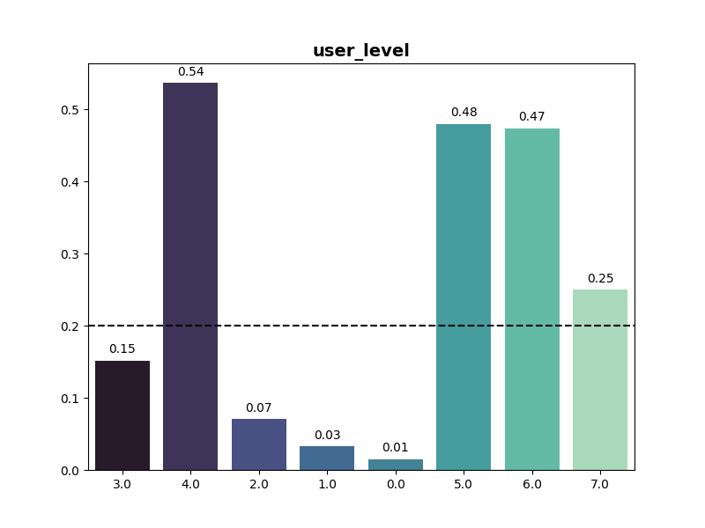
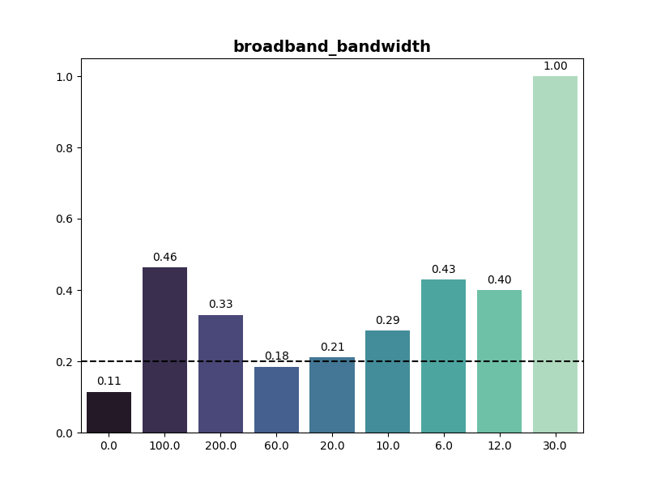
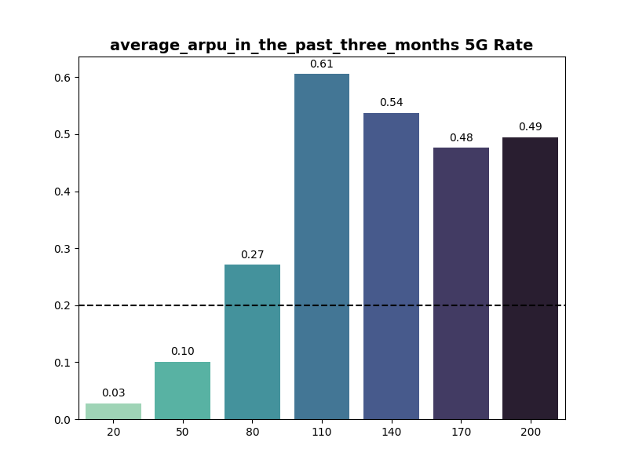
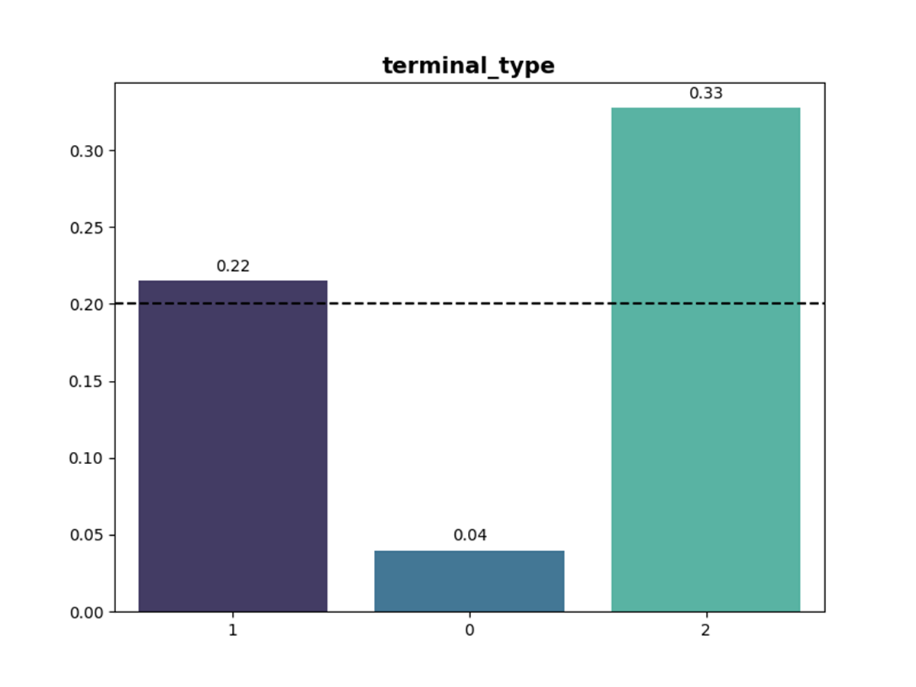
User Level
Broadband Width
5G Rate
The charts on the left show the categorical attributes that have a significant impact on the 5G adoption rate, using 0.2 as the benchmark.
Avg ARPU in Past 3 Months
Terminal Type
Cao Yawei

Slide 8
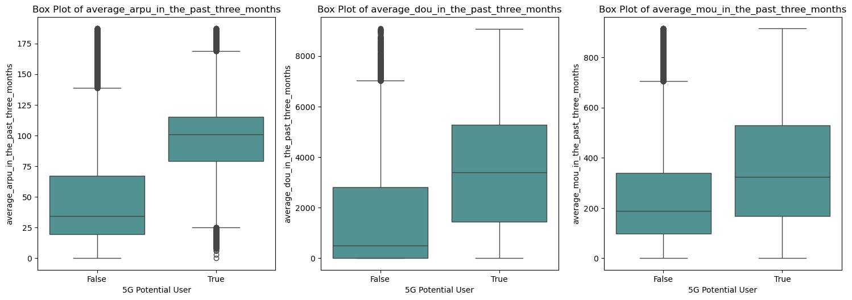
Key Variables of 5G Conversion
Variables Relationship
Analysis revealed key variables that are important and positively-correlated with customer adoption of 5G services.
Top 5 Important Features | Top 5 Positively-Correlated
Average ARPU | Average ARPU
Average DOU | User level 4
Average MOU | Broadband bandwidth
Age | Average DOU
Broadband bandwidth | Home user
Users with higher ARPU are more likely to convert to 5G. | Heavy data users are more inclined to upgrade to 5G. | Users who spend more time using services are more likely to adopt 5G.
Target Customers
Users with high ARPU, DOU, and MOU
Broadband users with higher bandwidth
Higher-tier customers (level 4)
Users with home network
Limeylia Ng
ARPU: Average Revenue Per User | DOU: Data Usage per User | MOU: Minutes of Usage

Slide 9
Machine Learning - Features Engineering
Feature Generation
Feature Selection
Standardization & Encoding
Features in current dataset reflect only static behavior.
Developed features based on past three months data to track average & trend.
Exist high degree of correlation among features in the dataset, may lead to several issues during model training.
Numerical features in the dataset have inconsistency.
Features with larger values may influence model training.
Correlation Analysis
Threshold : 0.9
Average Features
Numerical Features
StandardScaler
Mean = 0
Std. = 1
Voice Overage Fees
Data Overage Fees
Data Saturation Level
Features to Drop
Dataset includes categorical features with multiple categories like user level and segment.
3 Months Average
3 Months Average ARPU
3 Months Average MOU
Broadband Bandwidth
Is Boardband Activated
Is Boardband Contract Bundled
Main Package Fee
3 Months Avg Data Saturation Level
Trend Features
Categorical Features
Target
Encoding
Mean of “Label”
ARPU
DOU
MOU
Voice Overage Fees
Data Overage Fees
Data Saturation Level
Segment | Campus User | Corporate User | Normal User | Rural User
Encoded Segment | 0.120251 | 0.314981 | 0.206844 | 0.146179
Monthly Growth Rate
STEP 1
STEP 2
STEP 3
Generate 15 new features
Drop 7 highly correlated features
Adjust Numerical & Categorical Features
138918 Records | 59 Columns
138918 Records | 52 Columns
138918 Records | 52 Columns | All between 0 - 1
Note: ARPU: Average Revenue Per User | DOU: Data Usage per User | MOU: Minutes of Usage
Feng Wenzhuo

Slide 10
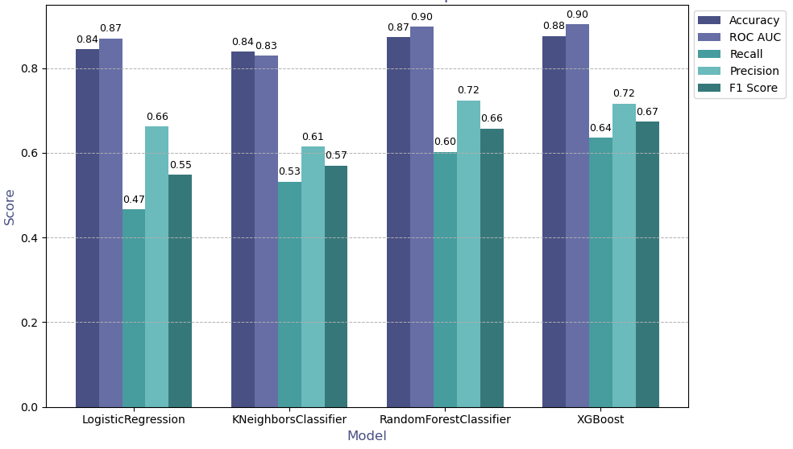
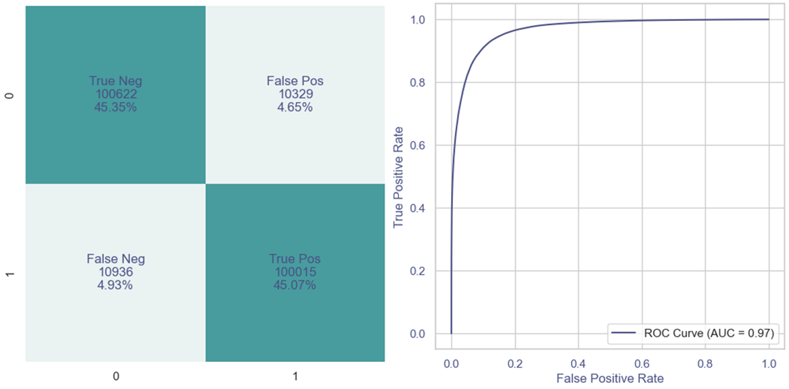
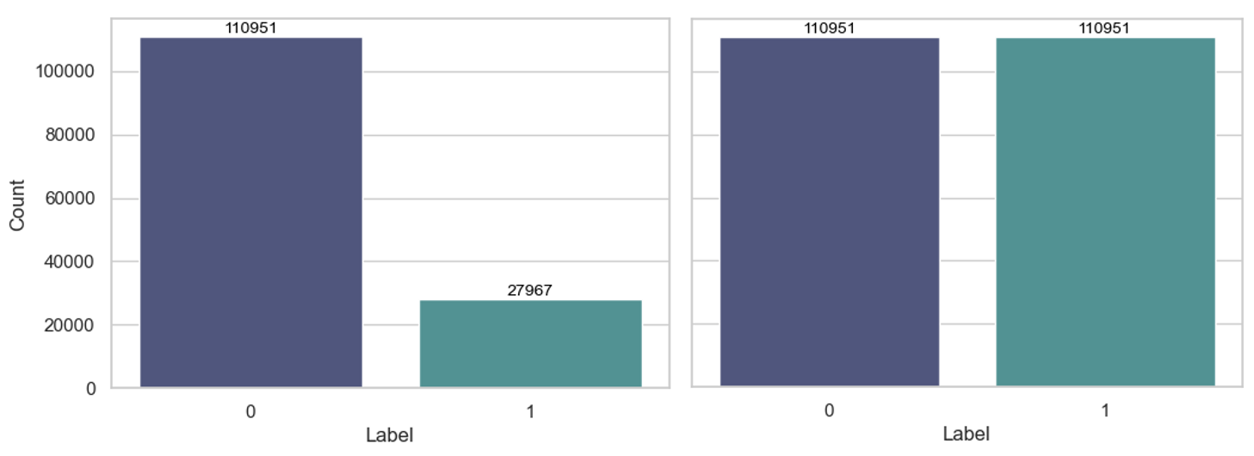
Machine Learning - Model Preparation
Evaluation Metrics
Model Performance with Unbalanced Data
Primary Model Evaluation Strategy :
5 Fold Cross-Validation
Model Performance Metrics
Confusion Matrix & ROC Curve
Accuracy
Precision
Recall
ROC AUC
F1 Score
Imbalanced Data Resampling
Initial machine learning models with high accuracy (0.84+) but low recall (0.64-).
Distribution of 0 and 1 samples is uneven, approximately 4:1, make the model to favor the majority class.
Use SMOTE to adjusted the ratio to 1:1 and get a balanced dataset.
Label Distribution Before and After SMOTE
SMOTE
Synthetic Minority Over-sampling Technique, generates synthetic minority samples to balance the ratio between positive and negative samples.
Feng Wenzhuo

Slide 11
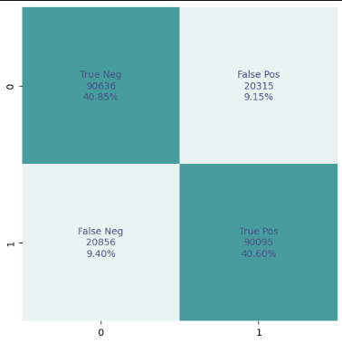
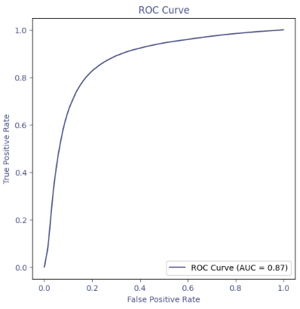
Machine Learning – Logistic Regression Model
Model Overview
Logistic Regression
Logistic Regression estimates class probabilities for binary classification by applying the logistic function to a linear combination of input features.
Logistic Regression Confusion Matrix and ROC Curve
Results and Analysis
Logistic Regression Model Performance Metrics
Model Name | Accuracy | AUC | Recall | Precision | F1 Score
Logistic Regression | 0.8143 | 0.8724 | 0.8118 | 0.8157 | 0.8134
Logistic Regression model achieved an accuracy of 81.43% and a high recall of 81.18%.
Accuracy means, out of 100 predictions whether a user will switch to 5G or not, about 81 were correct.
Recall means, if there are 100 actual 5G users, the model correctly identified about 81 of them.
Marcus Vos

Slide 12
Machine Learning – Logistic Regression Variants
Regression Variants
The Lasso variant (L1) improves prediction accuracy and interpretability by selecting and regularizing variables. The Ridge variant (L2) prevents overfitting by penalizing large coefficients and addressing multicollinearity. The Elastic Net variant (L1 and L2) combines and balances the benefits of both.
Logistic Regression Model Variants Performance Metrics
Model Name | Accuracy | AUC | Recall | Precision | F1 Score
Binary Logistic Regression | 0.8143 | 0.8724 | 0.8118 | 0.8157 | 0.8134
Lasso Logistic Regression | 0.8144 | 0.8724 | 0.8120 | 0.8158 | 0.8135
Ridge Logistic Regression | 0.8144 | 0.8724 | 0.8119 | 0.8158 | 0.8135
Elastic Net Logistic Regression | 0.8144 | 0.8724 | 0.8120 | 0.8158 | 0.8135
All variants of logistic regression provide similar performance across all metrics.
Consistent performance across variants could be due to the dataset having linear relationship between features and the target, with minimal noise.
Different regularization techniques did not significantly impact performance.
Marcus Vos

Slide 13
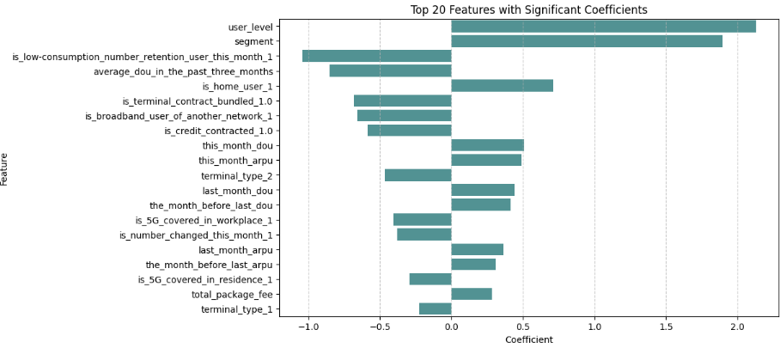
Machine Learning – Lasso Coefficients Analysis
Coefficient Analysis
Based on the coefficients from the lasso regression model, we identified the most significant factors influencing the likelihood of users switching from 4G to 5G.
Positive coefficients, such as User Level, User Segment, and Home User Status, indicate an increased likelihood of conversion to 5G.
Negative coefficients decrease the likelihood of conversion:
Low Consumption Retention User:
Low Average Data Usage (DOU)
Terminal Contract Bundled
Is Broadband User of Another Network
Is Credit Contracted
6 out of the 50 features in the lasso regression model have coefficients reduced to zero, indicating that these features provide no benefit to the model’s predictions.
Marcus Vos

Slide 14
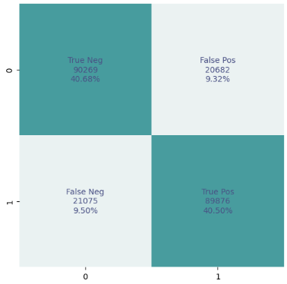
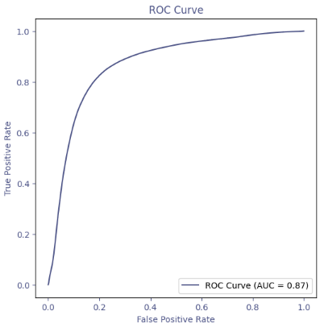
Machine Learning – Top 10 Features Logistic Regression
Model Overview
Logistic Regression
Top 10 Features Logistic Regression Confusion Matrix and
ROC Curve
Our testing revealed that using only the top 10 features determined by the coefficients from the lasso regression model is sufficient to build a satisfactory regression model.
Results and Analysis
Top 10 Features Logistic Regression Model Performance Metrics
Model Name | Accuracy | AUC | Recall | Precision | F1 Score
Top 10 Logistic Regression | 0.8118 | 0.8681 | 0.8100 | 0.8129 | 0.8113
Logistic Regression | 0.8143 | 0.8724 | 0.8118 | 0.8157 | 0.8134
Top 10 Logistic Regression model achieved similar performance metrics as the other logistic regression models.
By using the top 10 features , we can get similar model performance as compared to the original model which had 51 features.
Reducing the number of features to the top 9 causes the accuracy to drop to 0.72 .
This model with reduced feature requirements can be advantageous if data collection is costly.
Marcus Vos

Slide 15
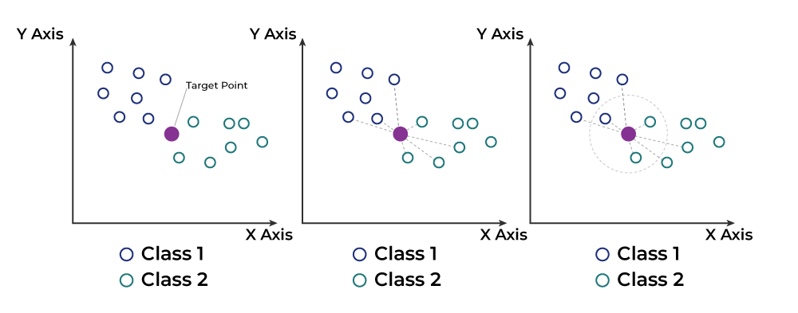
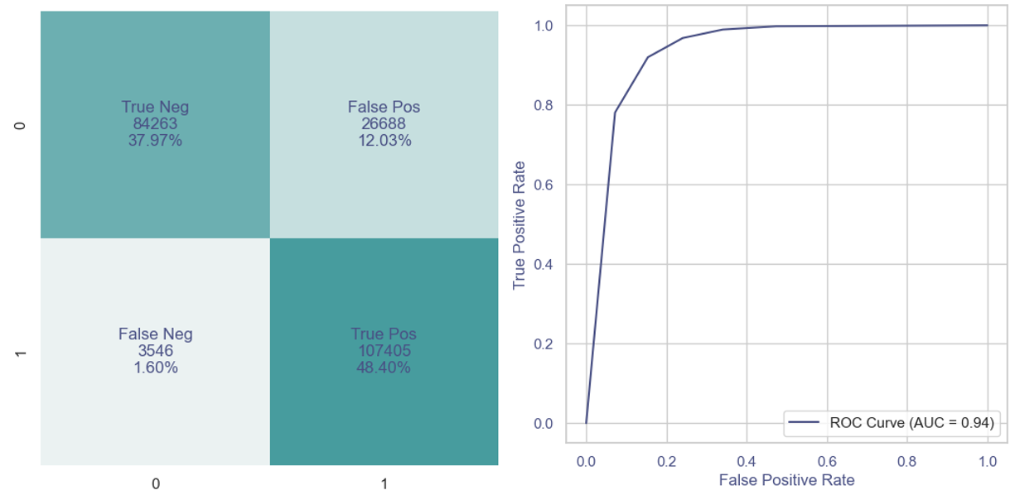
Machine Learning - KNN Model
Model Overview
KNN Algorithm
KNN
K-Nearest Neighbors (KNN) algorithm is a simple, instance-based learning method. It classifies a sample based on the majority class of its K-nearest neighbors, determined by a distance metric (e.g., Euclidean distance).
Results and Analysis
KNN Model Performance Metrics
KNN Model Confusion Matrix and ROC Curve
Model Name | Accuracy | AUC | Recall | Precision | F1 Score
KNN Model | 0.8638 | 0.9355 | 0.9680 | 0.8010 | 0.8766
KNN model achieved an accuracy of 86.38% and a high recall of 96.80%.
Highly effective at identifying positive class users, which aligns with our business goal of accurately recognizing positive users (e.g., 5G users).
Precision is 80.10%, showing that the model misclassifies more negative class users (non-5G users) as positive, incorrectly flagging them as 5G users.
Feng Wenzhuo

Slide 16
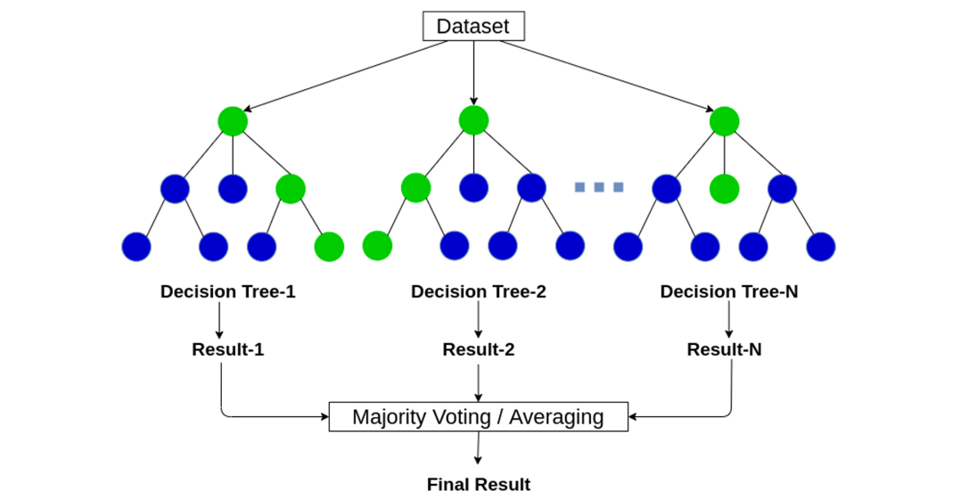
Machine Learning - Random Forest Model
Model Overview
Random Forest Algorithm
Random Forest
Random Forest algorithm builds multiple decision trees using different subsets of the data and combines their predictions. One of its key strengths is its ability to reduce overfitting, meaning it performs well on both the training and testing data.
Results and Analysis
Random Forest Model Performance Metrics
Random Forest Model Confusion Matrix and ROC Curve
Model Name | Accuracy | AUC | Recall | Precision | F1 Score
Random Forest | 0.9042 | 0.9705 | 0.9014 | 0.9070 | 0.8998
Random Forest achieved an accuracy of 90.42% and a recall of 90.14%.
Results indicate that RF model performs very well in identifying both positive and negative class samples, with a strong balance between sensitivity (Recall) and specificity.
The high Precision of 90.70% suggests that most positive samples predicted by the model are indeed true positives, reducing the number of false positives.
Feng Wenzhuo

Slide 17
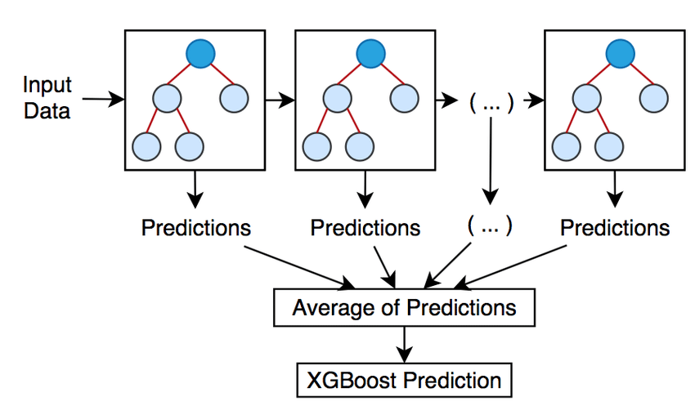
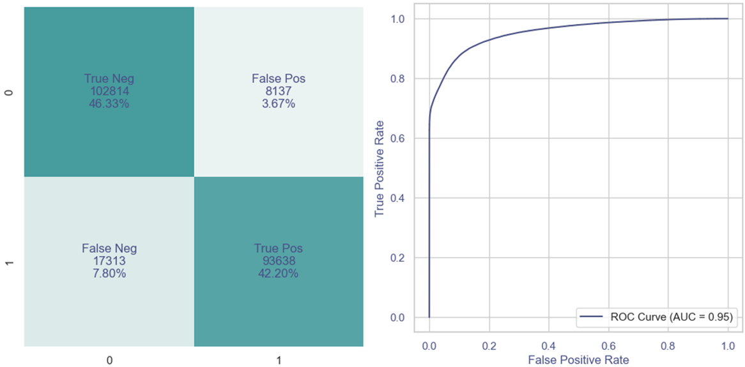
Machine Learning - XGBoost Model
Model Overview
XGBoost Algorithm
XGBoost
XGBoost is a gradient boosting framework. It builds multiple weak learners (typically decision trees) sequentially, where each new tree aims to correct the errors made by the previous ones. XGBoost is highly efficient for large datasets and excels in handling imbalanced data.
Results and Analysis
Random Forest Model Performance Metrics
Random Forest Model Confusion Matrix and ROC Curve
Model Name | Accuracy | AUC | Recall | Precision | F1 Score
XGBoost | 0.8853 | 0.9685 | 0.8440 | 0.9209 | 0.8596
XGBoost model achieved an accuracy of 88.53% and a recall of 84.40%.
While the recall is lower compared to KNN and Random Forest, the Precision is notably higher at 92.09%, meaning XGBoost is more effective at reducing false positives.
Feng Wenzhuo

Slide 18
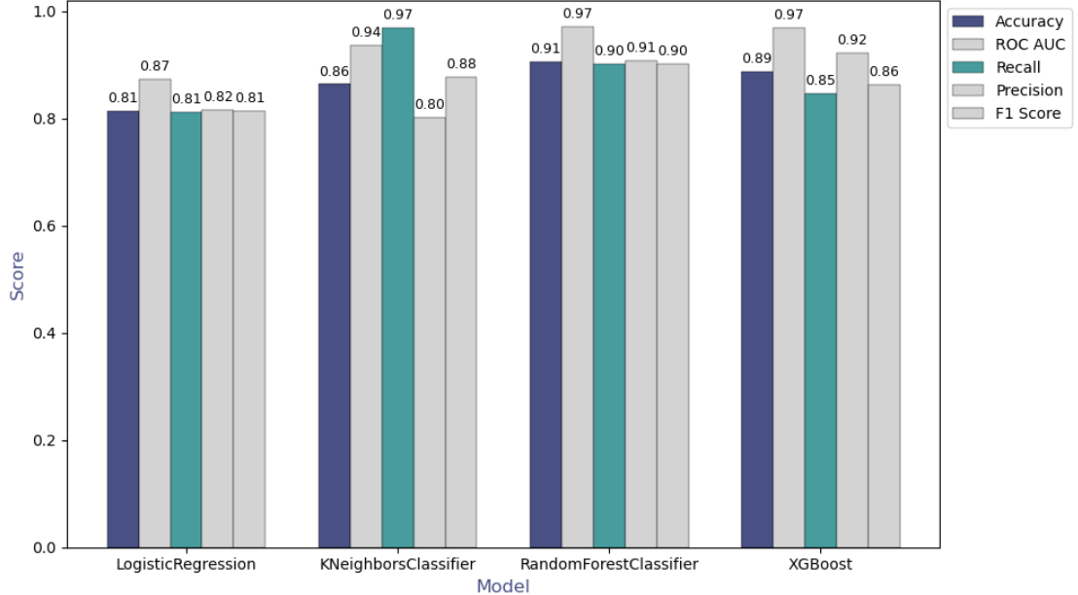
Machine Learning – Model Comparison
Model Performance Comparison
Results and Analysis
Logistic Regressions show balanced performance, with accuracy, AUC, recall, precision remaining stable at consistent levels.
KNN Model stands out with the highest recall (96.80%) but low precision (80.10%), meaning the model can identify most of potential 5G users but have a higher number of false positives.
Random Forest Model shows median recall (90.14%), along with high precision (90.70%), not only effective at identifying potential 5G users but also manages false positives well.
XGBoost Model achieves the highest precision (92.09%), excelling at minimizing false positives. However, its recall is comparatively lower (84.40%).
Business Requirement
Business
In the context of 5G business applications, expanding the marketing scope to include as many potential 5G users as possible, within acceptable cost limits, is the priority. Thus, the goal is to identify potential 5G users for targeted marketing, making recall the most critical metric.
Best Model
👑KNN
Feng Wenzhuo

Slide 19




Business Strategies
Target on ARPU, DOU & MOU
From the exploratory data analysis, we can conclude that the key factors influencing the switch to 5G are consumption-related variables, dataflow usage variables and voice usage variables.
High-spending Users
Call-focused Users
Data-hungry Users
Focus on promoting premium 5G plans with enhanced features:
Faster speeds
Exclusive content
Additional services
……
Promote the superior call quality and network stability of 5G:
HD voice calls
Video calls
Rich text messages
……
Encourage upgrade for a better experience of activities like:
Streaming
Gaming
Cloud Services
……
Zhang Hang
Notes:
Now, let’s see the business solutions from our data analysis. From the exploratory data analysis, we know that the key factors of 5g conversion are ARPU, DOU and MOU, which indicates revenue, dataflow usage and call minute. So target on these 3 types of users, we provide corresponding business strategies.

Slide 20


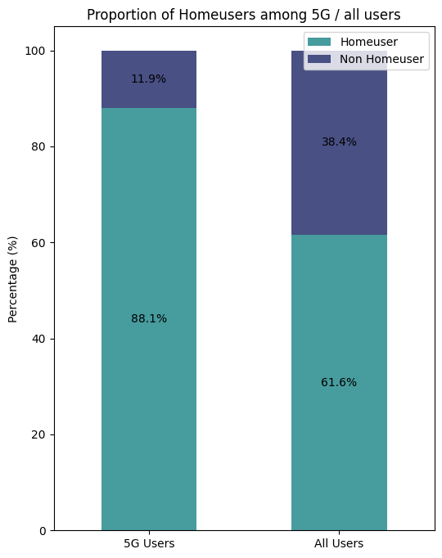



5G Household Bundles
Introduce family or household bundles that combine 5G mobile services with home broadband, TV, or home devices, offering discounted prices.
Family Shared Data Plans
Offer family shared data plans that allow multiple members to share 5G data within the same plan, making it easier to manage costs.
5G users are more likely to be home users compared to the overall user base. 88.1% of 5G users are home users, compared to 61.6% of all users.
5G-Enabled Smart Home Solutions
Business Strategies
Target on Home Users
Highlight the advantages of 5G for smart home devices (e.g., smart cameras), demonstrating how 5G can enhance home life.
Zhang Hang
Notes:
From EDA, we also know that among 5g users, the proportion of home users is nearly 90per, much higher than that among all users. So, to target on home users, we came up these strategies. The first one is to launch 5g household bundles, combing 5g service with broadband, TV, or other services. The second is to promote family shared data plan, attract subscribers with a fair price. The third one is to promote 5G based smart home solutions, demonstrating how 5G can enhance home life.

Slide 21


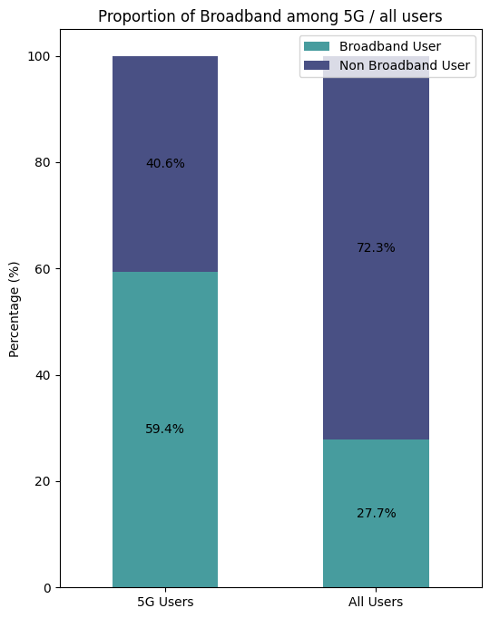


Network Bundling Discounts
Business Strategies
Target on Broadband Users
Provide existing in-network broadband users with exclusive discounts on bundled 5G mobile and broadband services.
Seamless Upgrade and Experience
Highlight the seamless transition between 5G and home broadband networks. Emphasize the superior, uninterrupted network experience.
Data Prioritization
Offer prioritized data speeds for broadband users on their 5G mobile plans, ensuring faster and more reliable connectivity when both networks are in use.
5G users are more likely to be broadband users compared to the overall user base. 59.% of 5G users are broadband users, compared to 27.7% of all users.
Zhang Hang
Notes:
There is same situation for broadband users as well. Broadband users account for 60% of 5g subscribers, while only account for 27 percent in all users. So, they are our potential customers. The first approach is giving Bundling Discounts to non 5G broadband users. Also, having the broadband and mobile data from the same provider, the company could promote its seamless experience of network transition between 5G and broadband. Then, Since broadband users value network experiences, we should give them data priority for both 5G and broadband network.
Then, let’s discuss about business application of our models.

Slide 22

Model Application in Business
Traditional 5G promotion relies on a broad-based approach, using large-scale marketing campaigns to reach as many potential 5G users as possible.
With the machine learning model, telecom operators can leverage data-driven insights to precisely target users who are most likely to transition from 4G to 5G.
Targeted Outreach
Tailor specific 5G plans and service offerings based on users' behavior.
Once high-potential customers are identified, operators can incentivize these users to upgrade by offering small discounts or promotions.
Operators can provide proactive technical support and upgrade assistance for potential users to accelerate their conversion to 5G.
+ 40%
Precision Marketing
—— Low Demand
Network Resource Optimization
Identify user groups most likely to upgrade to 5G and pinpoint their geographic distribution or user segment.
Prioritize the deployment of 5G base stations; Expand network capacity in these areas, ensuring that users receive high-quality service when transitioning to 5G.
—— High Demand
Feng Wenzhuo

Slide 23

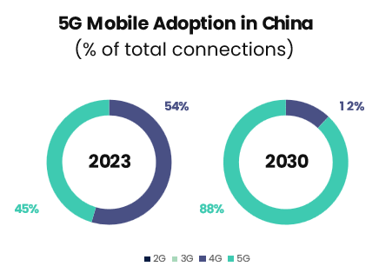
Conclusion
This data-driven strategy empowers the company to maximize customer adoption and resource optimization, securing its position in the 5G market.
Business Problem
Exploratory
Data Analysis
Machine Learning
Business Solutions
Accurate identification of potential 5G users for targeted marketing campaigns and optimized resource allocation
Feature Engineering
Model Preparation
Logistic Regression Model
Random Forest Model
XGBoost Model
Segmentation
ARPU, DOU & MOU
Home Users & Broadband Users
Unique patterns can be identified among different variables.
Top 5 Important Features | Top 5 Positively-Correlated
Average ARPU | Average ARPU
Average DOU | User level 4
Average MOU | Broadband bandwidth
Age | Average DOU
Broadband bandwidth | Home user
Model Application in Business
Targeted Outreach
Precision Marketing
Network Resource Optimization
Best Model | 👑KNN
accuracy 86.38%
recall 96.80%
Cao Yawei
Notes:
leverage data-driven models to drive business growth through targeted outreach, precision marketing, and network resource optimization.

Slide 24
Thank you for listening!
Leveraging Statistics & Machine Learning
to Accelerate 5G Adoption
A Strategic Approach for
Telecommunications Growth
AN6003 Group A – Team 9

